Slide 1
GoGreen Company
AWS Cloud Infrastructure Proposal
September 4, 2020

Slide 2

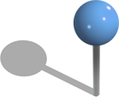

Go Green Offices
Office Locations include
Northern California – home office
London, England
Sao Paulo, Brazil

Slide 3
AWS Services used include
Service | description
Virtual Private Cloud | Secure and scalable architecture based in AWS us-west-1
EC2 | scalable computing capacity aws-linux instances
S3 Storage | Simple Storage Service is storage for the Internet
Route 53 | highly available Domain Name System (DNS) service
Cloud-front | Web content distributable service
AWS Aurora | database engine providing simplicity and cost-effectiveness
Security groups | way of filtering inbound and outbound traffic to a device
Network access control | optional layer of security for your VPC that acts as a firewall for controlling traffic in and out of one or more subnets.
Auto-scaling | monitors AWS applications adjusting capacity automatically to maintain steady, predictable performance at the lowest possible cost.
Application load balance | An AWS designed to handle streaming, real-time, and Web Socket workloads in an optimized fashion to optimize server efficiency
Network load balance | An AWS tool to distribute end user traffic across multiple cloud resources to ensure low latency and high throughput for applications.

Slide 4
User Policy IAM
Go-Green Company - Password Policy
Password Policy configured as followed
1 uppercase and 1 lowercase letter, 1 number, and 1 special character
Force password change
No re-use of previous three old password.
Sys admin
Dba admin
Monitor
EC2 to S3
Sys admin - 1
Dba admin - 1
Monitor-user - 1
Monitor-user - 1
Sys admin - 2
Dba admin - 2
Monitor-user - 2
Dba admin - 3
Monitor-user - 3
Monitor-user - 4

Slide 5
User permissions
Group name | Permissions
System administrators | Administrator access and management console.
Database Administrators | Full database access.
Monitor Users | Access to EC2, S3, and DB to monitor the application.

Slide 6
Web Tier
Requirement | Solution
Architecture must be flexible and handle any peak in traffic or performance. | Auto scaling and Elastic Load Balancing will be included.
300-750 mbps is the overall acceptable incoming network bandwidth. | Cloud watch is used to monitor events where notification of bandwidth in excess of 700 Mbps or lower than 300 Mbps enables auto scaling
Admins want to be notified by email if there are more than 100 “400 HTTP” errors per minute in the application. | Cloud watch will be configured where SMS will be used in the event of 400 HTTP errors.
Web tier instances need to be tagged as “Key: name” & “Value: web-tier.” | Instances will be tagged “key=name” and “value=web tier”
Instances selected are: | Quantity 6 of c5.large with 2 CPU, 4 Gb, with an on-demand cost of $0.1060, and potential eff. cost of $0.040

Slide 7
Application Tier
Requirement | Solution
Flexible to handle any peak in traffic or performance. | Elastic Load Balancing will distribute incoming application traffic across multiple targets and Auto-scaling will start or stop instances as needed
50-60% server capacity. | Elastic Load Balancing will be used to maintain consistency of memory and CPU values so work is distributed evenly.
Memory and CPU use should not go above 75-80% or below 30%. | Our configuration is quantity 5 of m5a.xlarge with 4 CPU, 16 Gb at a on-demand cost of $0.2020/hour and potential effective cost of $0.076/hour.
Internet access required for patching and updating without exposing the server. (NAT?) | A network address translation (NAT) gateway to enable instances in a private subnet to connect to the internet or other AWS services
“Key: name” and “Value: app-tier.” | Instances will be “tagged” with key=name, and value=app-tier

Slide 8
Database tier
Requirement | Solution
Database needs constant storage performance at 21,000 IOPS | Our solution is to use the AWS Amazon Aurora. It is a MySQL compatible relational database built for the cloud
High availability | Amazon Aurora is designed to offer greater than 99.99% availability, and if necessary replicate 6 copies of the data to as many as 3 Availability Zones continuously to Amazon S3.
No change to database schema | Amazon Aurora is fully compatible with existing MySQL, and adds compatibility for new releases regularly.
RPO | It Aurora, recovers from physical storage failures; instance failover typically takes less than 30 seconds.

Slide 9
Additional AWS Services
Service | Purpose
S3 Glacier | S3 Glacier is a secure, durable, and extremely low-cost Amazon S3 cloud storage classes for data archiving and long-term backup.
Code commit | CI/CD via GitHub
Cloud Watch | Cloud Watch collects and track real time metrics, which are variables used to measure resources and applications for issues.
IAM | Is a web service for securely controlling access to AWS resources. It enables administrators create and control services for user authentication or limit access to a certain set of people to AWS resources.
SNS | Amazon Simple Notification Service (Amazon SNS) is a web service that coordinates and manages the delivery or sending of messages to subscribing endpoints or clients.

Slide 10
VPC
Subnet name | VPC | Subnet Type | AZ | Subnet address
webserver1 | California | Public | us-west-1a | 10.0.10.0/24
webserver1 | California | Public | us-west-1b | 10.0.11.0/24
app1 | California | Private | us-west-1a | 10.0.20.0/24
app2 | California | Private | us-west-1b | 10.0.21.0/24
Database1 | California | Private | us-west-1a | 10.0.30.0/24
Database2 | California | Private | us-west-1b | 10.0.31.0/24

Slide 11
Recovery Point Objective
The servers are stateless therefore no RPO is needed.
Aurora maintains HA by having Read Replicas in the other Availability Zone. This is managed by AWS
Aurora automatically fails over to a replica in case the primary DB instance becomes unavailable.
For the Aurora- MySQL database engines, Amazon RDS, which Aurora is part of, creates a second DB instance using a snapshot of the source DB instance.
Amazon RDS runs on the same highly reliable infrastructure used by other Amazon Web Services. When you provision a Multi-AZ DB Instance, Amazon RDS synchronously replicates the data to a standby instance in a different Availability Zone (AZ). Amazon RDS has many other features that enhance reliability for critical production databases, including automated backups, database snapshots, and automatic host replacement.

Slide 12
Document Storage
Tool/type | Details
S3 | Amazon S3 is a simple storage service.
S3- Glacier | With a time period of 5 years after accepting data from the S3, Glacier will be used as a secure, durable, long-term backup.

Slide 13
The explanation of the diagrams. Essentially, they are the same
At “route 53” the client/guest, unaware that they are using DNZ logs onto a Windows server. If there are hundreds or thousand of of users', the network load balancer can scale up or down accordingly . This is tier 1. Initially, cloudfront checks S3 and S3 Glacier for any past requests
The client request is processed on AWS Linux servers on the application tier, or tier 2. Using application load balancers, regardless if there are only 10’s of users, or thousands of users, the VPC can scale up or down accordingly to adjust to demand.
Records are retained on a MySQL database and replication saved to an Aurora database. This tier, tier 3, also utilizes “cloudwatch” for system issues and if necessary SES, simple email service, and SMS for simple messaging service

Slide 14
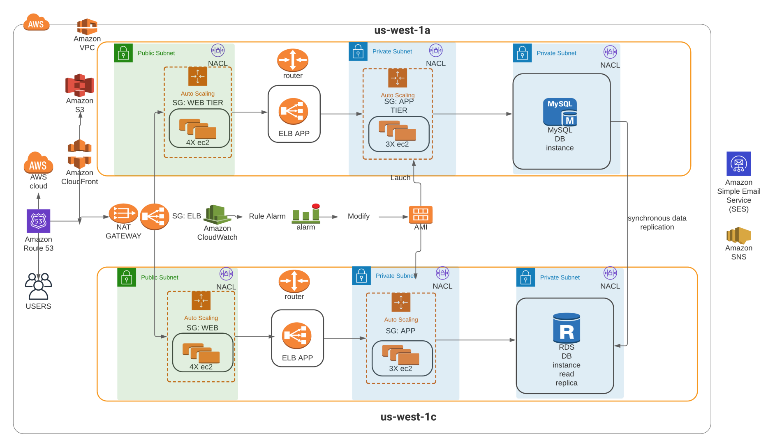
Team 2 Infrastructure

Slide 15
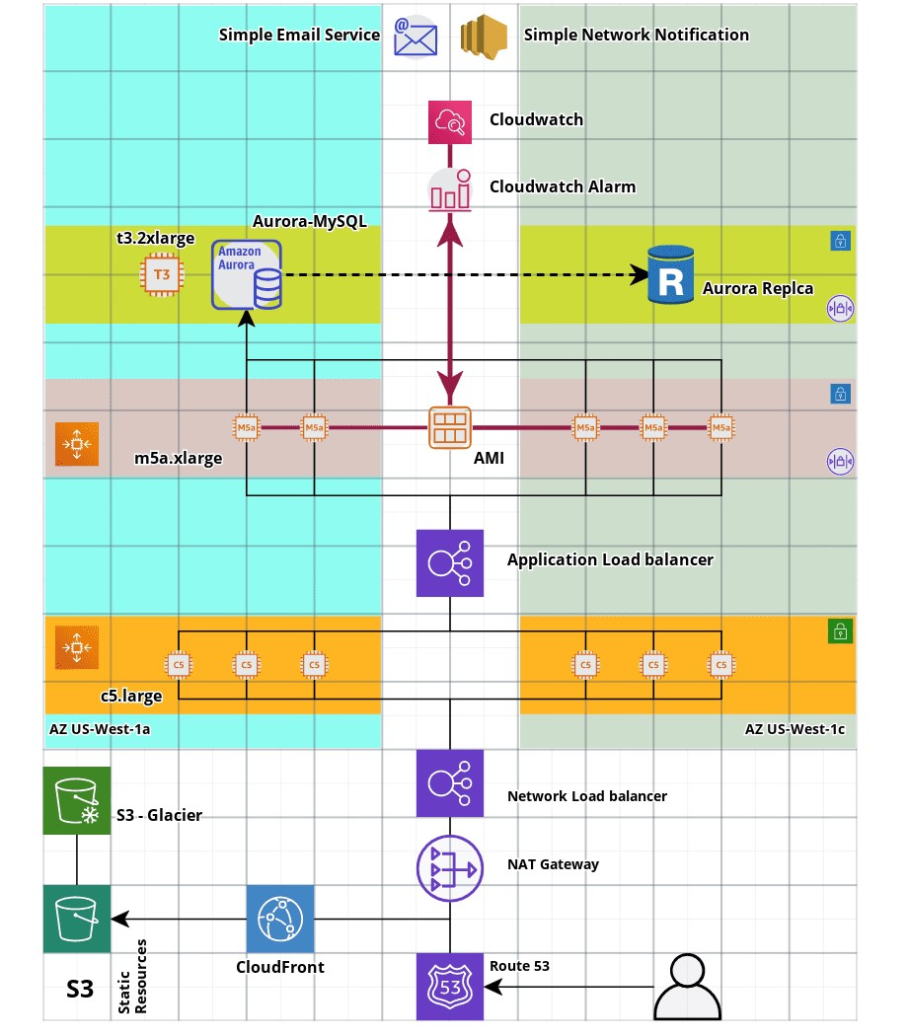

Slide 16
Terraform files on GitHub
https://github.com/Tylke/terraform-based-pipeline/tree/master

